Slide 1
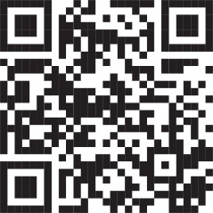
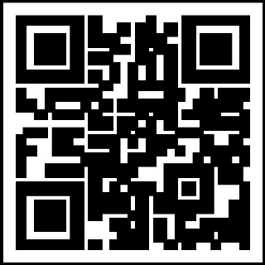
THE
IG Update
Volume 24-3, April 2024
Army Suicide Prevention Program
The Army is committed to reducing suicide through a comprehensive program integrating suicide prevention strategies and activities to prevent self-harm or harming others.
In August 2023, the Army published Army Regulation 600-92, Army Suicide Prevention Program (ASPP).
AR 600-92 lays out in-depth policies addressing risk and protective factors in order to reduce self-directed and other harmful behaviors.
The ASPP educates and trains active duty, reserve and National Guard Soldiers, Army Civilians and Family members on suicide prevention and postvention actions to minimize the risk of suicide.
The ASPP website (listed below) also provides a wealth of resources for leaders at all levels, as well as links to crisis intervention and suicidal ideation or self-harm behaviors to watch for.
Unit patch/logo
goes here
https://www.veteranscrisisline.net/
https://988lifeline.org/
Text: 838255
OCONUS phone numbers (all DSN 988):
EUROPE: 844-702-5495
PACIFIC: 844-702-5493
SW ASIA: 855-422-7719
Your Unit Name
Commanding General
MG Soldier Q. Public
Command Sergeant Major
CSM Soldier Q. Public
Command Inspector General
LTC Soldier Q. Public
Inspector General NCOIC
SGM Soldier Q. Public
IG Points of Contact
Unit IG Office
Building 1234
Hooah Drive
Fort Swampy XX 55555
“Every single suicide is one tragedy too many…The Army is committed to supporting those exposed to harmful behaviors and doing everything we can to address this critical issue.”
– Secretary of the Army Christine E. Wormuth
When someone needs help, remember ACE:
Ask your battle buddy or Family member if he or she is thinking about harming themselves. Asking won’t increase the likelihood that they will commit suicide.
Care for your battle buddy or Family member by listening and reassuring them that immediate help is available. Calmly talk to them and remove any means that they might use to harm themselves.
Escort your battle buddy or Family member to get help. This can be an emergency room, a primary care provider, or a behavioral health professional. If they refuse to go with you, do not leave them alone.
Call 988 if necessary.
Regulations and Resources:
AR 600-92: Army Suicide Prevention Program
Army Suicide Prevention Program website: https://www.armyresilience. army.mil/suicide-prevention/ index.html
Military OneSource (free counseling): 800-342-9647 or 703-253-7599
DoD Employee Assistance Program: 866-580-9046
https://ig.army.mil

